Slide 1


Beatriz Jimenez Franco 03-07-2023
https://github.com/singulritarian7/Capstone-Spacex

Slide 2

Outline
Executive Summary
Introduction
Methodology
Results
Conclusion
Appendix
2

Slide 3
Summary of methodologies
Data Collection through API
Data Collection with Web Scraping
Data Wrangling
- Exploratory Data Analysis with SQL
Executive Summary
- Exploratory Data Analysis with Data Visualization
- Interactive Visual Analytics with Folium
Machine Learning Prediction
Summary of all results
Exploratory Data Analysis rand predictive analytics result
Interactive analytics in screenshots
4

Slide 4

Project background and context
We will predict if the Falcon 9 first stage will land succesfully..SpaceX advertises Falcon 9 rocket launches on its website, with a cost of 62 million dollars; other providers cost upward of 165 million dollars each, much of the savings is because SpaceX can reuse the first stage. Therefore if we can determine if the first stage will land, we can determine the cost of a launch. This information can be used if an alternate company wants to bid against SpaceX for a rocket launch.
Problems you want to find answers
- What factors determine if the rocket will land successfully?
- The interaction amongst various features that determine the success rate of a successful landing.
- What operating conditions needs to be in place to ensure a
successful landing program.
Introduction
4

Slide 5

Section 1 Methodology
4

Slide 6



Methodology
Executive Summary
Data collection methodology:
Data was collected using SpaceX API (Rest API) and web scraping from Wikipedia.
Perform data wrangling
One-hot encoding was applied to categorical features
Perform exploratory data analysis (EDA) using visualization and SQL
Perform interactive visual analytics using Folium and Plotly Dash
Perform predictive analysis using classification models
How to build, tune, evaluate
classification models
6

Slide 7

Describe how data sets were collected.
- Data collection was done using get request to the SpaceX API.
- Next, we decoded the response content as a Json using .json() function call and turn it into a pandas dataframe using
.json_normalize().
- We then cleaned the data, checked for missing values and fill in missing values where necessary.
- In addition, we performed web scraping from Wikipedia for Falcon 9 launch records with BeautifulSoup.
- The objective was to extract the launch records as HTML table, parse the table and convert it to a pandas dataframe for future analysis
8

Slide 8

Data Collection – SpaceX API I
We used the get request to the SpaceX
API to collect data, clean the requested
Collecting the data with the API call
data and did some basic data wrangling
and formatting.
The link to the notebook is
Convert the data
Converting to dataframe the Jason result
to csv file
https://github.com/singulritarian7/Capsto ne-Spacex/blob/master/jupyter-labs-
spacex-data-collection-api%20(9).ipynb
Data cleaning and
Updating columns and rows
filling in
the mising values
Filtering the data to keep
only Falcon 9
launches
8

Slide 9
Steps for data collection from API:
Request data from Spacex API using the url.
Convert the Jason result into a dataframe
Filter between needed and redundant data
Empy lists generation and helper function to extract data
Populate empty list with extracted columns data
Create a dictionary combining the columns data
Create a new dataframe and filter it with only Falcon 9 launches
Data wranling (dealing with missing values)
Data Collection
– SpaceX API II

Slide 10
Request the data from Spacex API
Transform jason respond to dataframe
IFilter between needed and redundant data
Data collection- Spacex API III
Empty lists generation and helper functions
Fill in lists with extracted data and create dataframe
Filter only Falcon 9 data
Data wrangling

Slide 11
Data Collection – Scraping I
We applied web scrapping to Falcon
Request the Falcon launch page from its url of wikipedia.
9 launch records with BeautifulSoup
We parsed the table and converted it
Create a Beautiful
soup objet with
into a pandas dataframe.
The link to the notebook
Export the data to csv
the HTLM response
https://github.com/singulritarian7/Capst
one-Spacex/blob/master/jupyter-labs-
Transform the dictionary to a pandas dataframe
Extract column names from the table header
webscraping%20(4).ipynb
Create an empty dictionary
11

Slide 12

Data colle
THE STEPS FOR WEB
SCRAPING ARE:
1- REQUEST THE
2- FIND TABLES
WITH DATA OBJET OF
STUDY
3- ITERATE THROUGH THE TABLES TO EXTRACT THE DATA
4- CREATE AN EMPTY
DICTIONARY TO FILL IN
5- APPEND EXTRACTED
DATA TO DICTIONARY
WIKI PAGE OF SPACEX
FALCON 9 LAUNCH
6- CREATE DATAFRAME FROM DICTIONARY

Slide 13
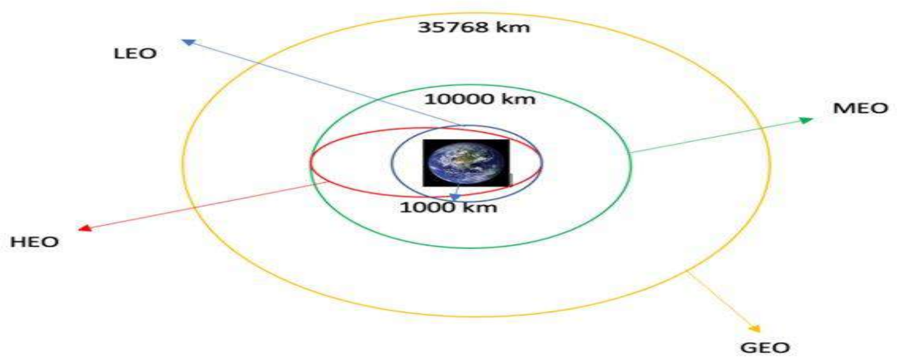
Some types of orbits of each launch

Slide 14
Data Wrangling II
We will perform EDA and determine training labels
 Calculate :
Number of launches for each site
Number and ocurrent of each orbit
Number and ocurrence of mission per orbit type
Create binary landing outcome as the dependent variable
Calculate the success rate
Export data to csv

Slide 15
Data Wrangling III
Loading the dataset and perform EDA
Calculate the outcomes or training labels
Finding the set of bad
outcomes (Falses and Nones)
Presenting outcomes as 0 or 1
Determinate the success rate
Export the dataset to csv file

Slide 16
 We want to make visualizations to select important variables that we
will use to predict the success in landing.
Scatter plots (cat plots) were used to view the relationships of categorical independent variables like Launch Site, Flight Number, Payload Mass and orbit type. We overlay the class label in each graph.
• A bar chart was used to visualize the success rate of each orbit type.
• A line chart was used to visualize the launch success yearly trend.
The Github url is :
https://github.com/singulritarian7/Capstone- Spacex/blob/master/jupyter-labs-eda- dataviz.ipynb.jupyterlite%20(1).ipynb
EDA with Data Visualization I
17

Slide 17

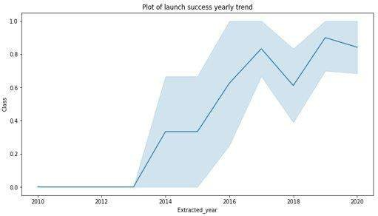
EDA with Data Visualization II
We will use the bar chart to determine which orbits have the highest probability
of success and the line graph to show the launch success yearly trend.

Slide 18
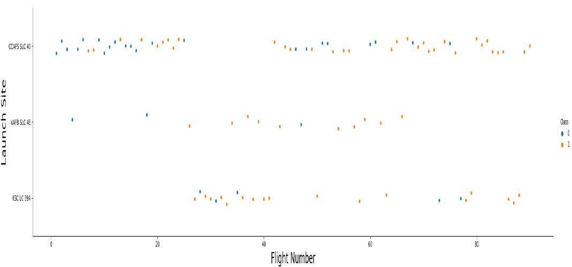
EDA with Data Visualization III
We make scatter plots to see the relationships between the following attributes:
Payload and flight number
Flight number and launch site 3-Payload and launch site
4- Flight number and orbit type 5- Payload and orbit type
Launch site versus flight number for each class scatter plot

Slide 19
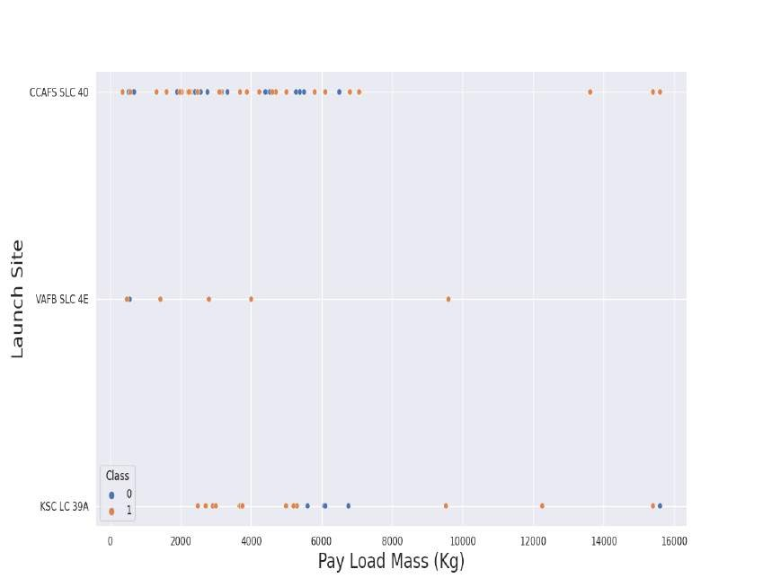
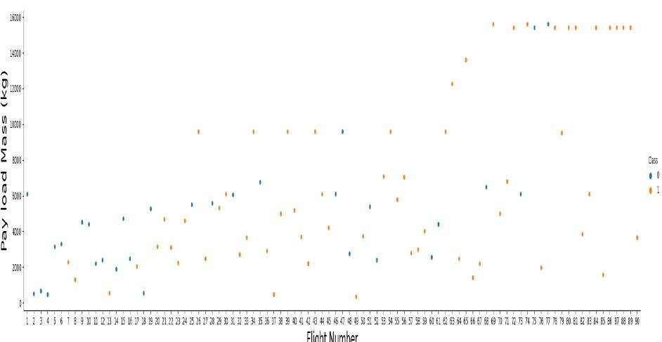
EDA with data visualization IV
Scatter plots show depemdency of attributes on each other
We also want to observe if there is any relationship between flight number and their payload mass for wach class.

Slide 20
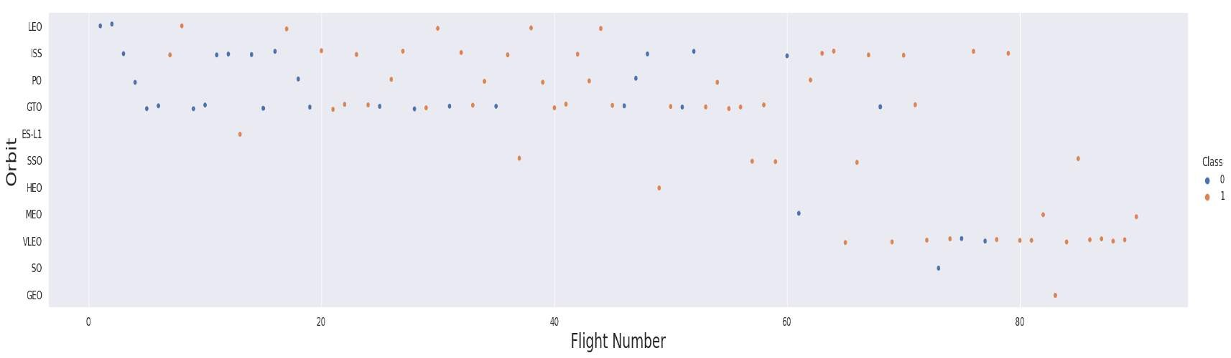
EDA with data visualization V
Visualize the relationship between Flight Number and Orbit Type for each class

Slide 21
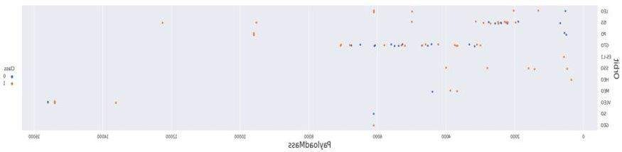
 Visualize the relationship between Payload and Orbit type for each class , this time with an example of code.
sns.catplot(y="Orbit", x="PayloadMass",
hue="Class", data=df, aspect = 5)
plt.xlabel("PayloadMass",fontsize=20)
plt.ylabel("Orbit",fontsize=20)
plt.show()
EDA withdata visualizationVI
Plot of Payload mass versus
Orbit for each class

Slide 22

 We used the SpaceX dataset into a PostgreSQL database in the cloud using a jupyter notebook.
We wrote queries to find out :
The names of unique launch sites in the space mission.
The total payload mass carried by boosters launched by NASA (CRS)
The average payload mass carried by booster version F9 v1.1
The total number of successful and failure mission outcomes
The failed landing outcomes in drone ship, their booster version and launch site names.
EDA with SQL
Add the GitHub URL
https://github.com/singulritarian7/Capstone- Spacex/blob/master/jupyter-labs-eda-sql- coursera_sqllite%20(6).ipynb
23

Slide 23
We marked all launch sites, and added map objects such as markers, circles, lines to mark the success or failure of launches for each site on the folium map.
We assigned the feature launch outcomes (failure or success) to
class 0 and 1.i.e., 0 for failure, and 1 for success.
Using the color-labeled marker clusters, we identified which launch sites have relatively high success rate.
We calculated the distances between a launch site to its proximities. We answered some question for instance:
 Are launch sites near railways, highways and coastlines.
Build an Interactive Map with Folium
 Do launch sites keep certain distance away from cities.
 https://github.com/singulritarian7/Capstone- Spacex/blob/master/06_SpaceX_Interactive_Visual_Analytics_F olium%20(1).ipynb
24

Slide 24
Predictive Analysis (Classification)
We loaded the data
using numpy and pandas, transformed the data, split our data into training and testing.
We built different machine
We used accuracy as the metric for our model, improved the model using feature engineering and algorithm tuning.
learning models and tune
We found the best performing classification model.
different hyperparameters
using GridSearchCV.
https://github.com/singulritarian7/Capstone- Spacex/blob/master/SpaceX_Machine_Learning_Prediction_Part_5.jupyterlite%20(1).ipynb
25

Slide 25
We built an interactive dashboard with Plotly dash
We plotted pie charts showing the total launches by a
certain sites
We plotted scatter graph showing the relationship with Outcome and Payload Mass (Kg) for the different booster version.
The link to the notebook is
https://github.com/singulritarian7/Capstone- Spacex/blob/master/spacex_dash_app.py
Build a Dashboard with Plotly Dash
26

Slide 26
 Exploratory data analysis results
Interactive analytics demo in screenshots
Predictive analysis results
Results
27

Slide 27
Insights drawn from EDA

Slide 28
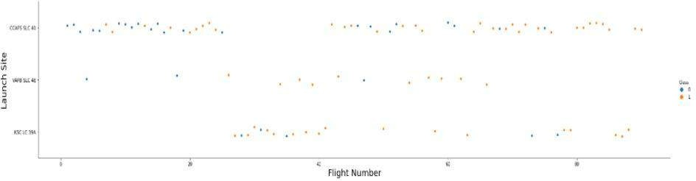
From the plot, we found that the larger the flight amount at a launch site, the greater the success rate at a launch site.
Flight Number vs.
Launch Site

Slide 29
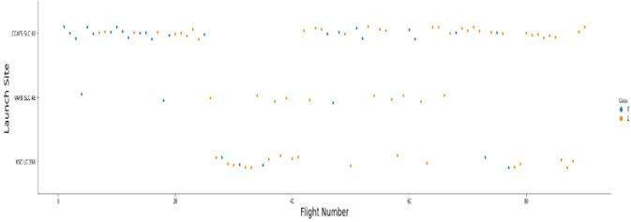
The greater the payload mass for launch site, the higher the success rate
Payload vs. Launch Site

Slide 30

Success Rate vs. Orbit Type
From the plot, we can see that ES-L1, GEO, HEO, SSO, VLEO had the most success rate

Slide 31
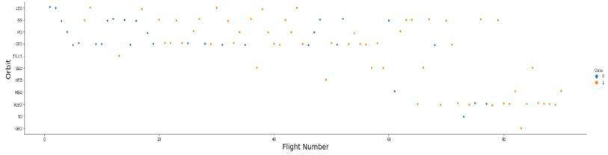
 The plot below shows the Flight Number vs. Orbit type. We observe that in the LEO orbit, success is related to the number of flights whereas in the GTO orbit, there is no relationship between flight number and the orbit.
Flight Number vs. Orbit Type

Slide 32
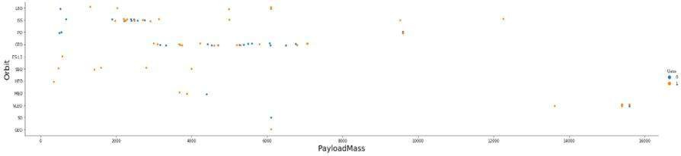
 We can observe that with heavy payloads, the successful landing are more for PO, LEO and ISS orbits.
Payload vs. OrbitType

Slide 33

Launch Success Yearly Trend
From the plot, we can observe that success rate since 2013 kept
on increasing till 2020.

Slide 34
All Launch Site Names
Launch_Site
CCAFS LC-40
VAFB SLC-4E
KSC LC-39A
 We used the key
word DISTINCT to show only unique launch sites from the SpaceX data
CCAFS SLC-40
None
Task 1
Display the names of the unique launch sites in the space mission
In [8]:
%sql SELECT Distinct LAUNCH_SITE FROM SPACEXTBL

Slide 35
 Display 5 records where launch sites begin with the string 'CCA'
 Task 2
 In [9]:
 %sql SELECT * \
Launch Site Names Begin with 'CCA'
 We used the next query to display 5 records where launch sites begin with `CCA`


FROM SPACEXTBL \
WHERE LAUNCH_SITE LIKE'CCA%' LIMIT 5;
 See the results of the
query in the next slide

Slide 36
Date_{a}
Time
(UTC)
Booster_V
ersion
Launch_Si
te
PAYLOAD
_MASS
KG_
Mission_O
utcome
Landing_
Outcome
L
unch S
ite Na
mes B
Payload
Orbit
Customer
egin w
ith 'CC
A'
Dragon Spacecraft Qualificati on Unit
06/04/201
0
F9 v1.0
CCAFS LC-
40
Failure (parachute
18:45:00
0.0
LEO
SpaceX
Success
B0003
)
We use
d this que
ry to displ
ay 5 recor
ds where
launch sit
es begin
with `C
Task 2
Display 5
%sql SELECT
FROM SPA
C
Dragon demo flight C1,
CCAFS LC- two
40 CubeSats,
barrel of Brouere cheese
A`
records wh
* \ EXTBL \
F9 v1.0
NASA (COTS)
NRO
Failure (parachute
12/08/2010
15:43:00
ere launch s
ites begin w
ith the strin
g 'CCA'
0.0 LEO (ISS)
Success
B0004
)
*
 In [9]:
C
WHERE LA
;
U
NCH_SITE LIKE'C
C
A%' LIMIT 5
Dragon demo flight C2
22/05/2012
7:44:00
F9 v1.0
CCAFS LC-
40
525.0 LEO (ISS)
NASA (COTS)
Success
No attempt
B0005
10/08/2012
0:35:00
F9 v1.0
CCAFS LC-
40
SpaceX CRS-1
500.0 LEO (ISS)
NASA (CRS)
Success
No attempt
B0006
03/01/2013
15:10:00
F9 v1.0 B0007
CCAFS LC-
40
SpaceX CRS-2
677.0 LEO (ISS)
NASA (CRS)
Success
N
37

Slide 37
We calculated the total payload carried by boosters from NASA using the next query
Task 3
Display the total payload mass carried by boosters
launched by NASA (CRS)
 In [10]:
%sql SELECT SUM(PAYLOAD_MASS KG_) \
Total Payload
Mass
FROM SPACEXTBL \
WHERE CUSTOMER = 'NASA (CRS)';
 SUM(PAYLOAD_MASS KG_)
 45596.0

Slide 38
We calculated the average payload mass carried by booster version F9 v1.1 as 2928.4
Task 4
Display average payload mass carried by booster version F9 v1.1
 In [11]:
%sql SELECT AVG(PAYLOAD_MASS KG_) \
Average Payload Mass by F9 v1.1
FROM SPACEXTBL \
WHERE BOOSTER_VERSION = 'F9 v1.1';
 AVG(PAYLOAD_MASS KG_)
 2928.4

Slide 39
We observed that the dates of the first successful
landing outcome on ground pad was 22nd December 2015
Task 5
List the date when the first succesful landing
outcome in ground pad was acheived.
Hint:Use min function
 In [12]:
%sql SELECT min(date) from SPACEXTBL where
"Landing_Outcome" = 'Success (ground pad)
min(date)
 01/08/2018
First Successful
Ground Landing Date

Slide 40
 We used the WHERE clause to filter for boosters which
have successfully landed on drone ship and applied
the AND condition to determine successful landing with payload mass greater than 4000 but less than 6000
Task 6
List the names of the boosters which have success in drone ship and
have payload mass greater than 4000 but less than 6000
%sql SELECT BOOSTER_VERSION FROM SPACEXTBL WHERE
PAYLOAD_MASS KG_ between 4000 and 6000 AND LANDING__OUTCOME='Success (drone ship)';
booster_version
 F9 FT B1022
 F9 FT B1026
 F9 FT B1021.2
 F9 FT B1031.2
Successful Drone Ship Landing with Payload between 4000
and 6000

Slide 41
We used wildcard like ‘%’ to filter
for WHERE MissionOutcome was a success or a failure. The number of success missionoutcomes are 101.
Task 7
List the total number of successful and failure mission outcomes
 In [ ]:
%sql SELECT COUNT(*) FROM SPACEXTBL WHERE MISSION_OUTCOME LIKE '%Success%' OR MISSION_OUTCOME LIKE '%Failure%'
COUNT(*)
 101
Total Number of Successful
and
Failure Mission Outcomes

Slide 42
 We determined the booster that have carried the maximum payload using a subquery in the WHERE clause and the MAX() function.
Boosters Carried Maximum Payload I
Task 8
List the names of the booster_versions which have carried
the maximum payload mass. Use a subquery
 In [14]:
%sql SELECT BOOSTER_VERSION FROM SPACEXTBL WHERE PAYLOAD_MASS KG_ = (SELECT MAX(PAYLOAD_MASS KG_) FROM SPACEXTBL)
See the results in the next slide

Slide 43
Booster_Version F9 B5 B1048.4 F9 B5 B1049.4 F9 B5 B1051.3 F9 B5 B1056.4 F9 B5 B1048.5 F9 B5 B1051.4 F9 B5 B1049.5 F9 B5 B1060.2 F9 B5 B1058.3 F9 B5 B1051.6 F9 B5 B1060.3 F9 B5 B1049.7
Boosters Carried
Maximum
Payload II

Slide 44
outcomes in drone ship, their booster versions,
 We used the WHERE clause to filter for failed landing
and launch site names for year 2015
Task 9
List the records which will display the month names, failure lan
ding_outcomes in drone ship ,booster versions, launch_site for
the months in year 2015.
Note: SQLLite does not support monthnames.
So you need to use substr(Date, 4, 2)
as month to get the months and substr(Date,7,4)='2015' for yea r.
 In [38]:
%sql SELECT substr(Date,4,2) as month,
DATE,BOOSTER_VERSION, LAUNCH_SITE,
'Landing _Outcome' \
FROM SPACEXTBL \
where 'Landing _Outcome' = 'Failure (drone ship)'
and substr(Date,7,4)='2015';
 See the results in the next slide
2015 Launch Records I

Slide 45
month | Date | Booster_Version | Launch_Site | Landing _Outcome
01 | 10-01-2015 | F9 v1.1B1012 | CCAFS LC-40 | Failure (drone ship)
04 | 14-04-2015 | F9 v1.1 B1015 | CCAFS LC-40 | Failure (drone ship)
10-01-2015
2015 Launch Records II Results

Slide 46
Rank Landing Outcomes Between 2010-06-04 and 2017-03-20
We selected Landing outcomes and
the COUNT of landing outcomes from the data and used the WHERE clause to filter for landing
outcomes BETWEEN 2010-06-04 to 2010-03-20.
We applied the GROUP BY clause to
group the landing outcomes and the ORDER BY clause to order the
grouped landing outcome in descending order.
Task 10
Rank the count of successful landing_outcomes between the date 04-06-2010 and 20-03-2017 in descending order.
In [37]:
%sql SELECT [Landing _Outcome], count(*) as count_outcomes \
FROM SPACEXTBL \
WHERE DATE between '04-06-2010' and
'20-03-2017' group by [Landing
_Outcome] order by count_outcomes DESC;
See the results in the next slide
47

Slide 47
Landing _Outcome
count_outcomes
Rank Landing Outcomes Between 2010-06-
04 and 2017-
03-20
Success
20
No attempt
10
Success (drone ship) | 8
Success (ground pad) | 6
Failure (drone ship) | 4
Failure | 3
Controlled (ocean) | 3
Failure (parachute) | 2
No attempt | 1

Slide 48

Section 4
Launch Sites Proximities Ana
lysis

Slide 49
 • Folium Markers were used to show the SpaceX launch sites and their nearest important landmarks like railways, highways, cities and coastlines.
• Polylines were used to connect the launch sites to
their nearest land marks.
• Furthermore, Folium Circles were used to highlight
circle area of launch sites.
• In order to mark the success/failed launches for each site, marker clusters were used on the map. Whereby Red represents rocket launch failures while Green represents the successes.
Url of Github notebook, you can open it in Colab too to see the images.
https://github.com/singulritarian7/Capstone- Spacex/blob/master/Week_3_(A)Interactive_Visual_Analyt ics_with_Folium_(1).ipynb
Folium Map Summary
50

Slide 50

Launch sites global map markers
51

Slide 51
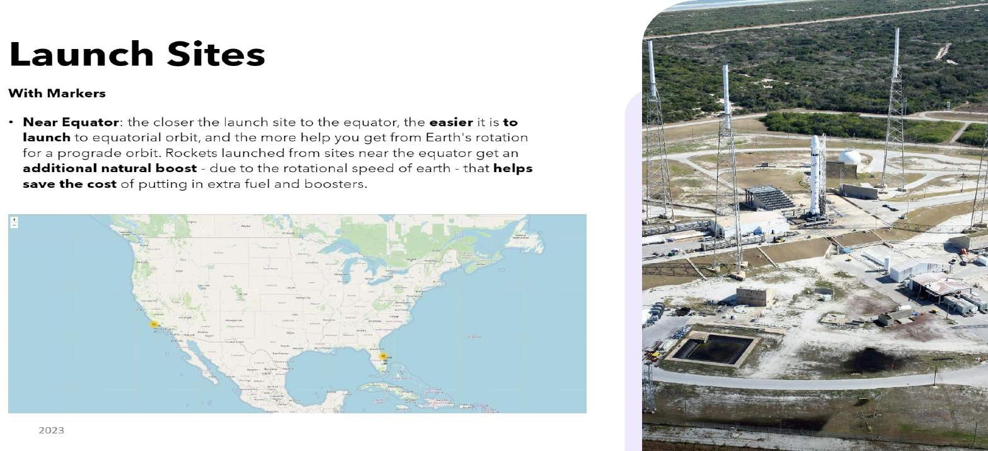
Now, you can explore the map by zoom-in/out the marked areas , and try to answer
the following questions:
Are all launch sites in proximity to the Equator line?
Are all launch sites in very close proximity to the coast?

Slide 52
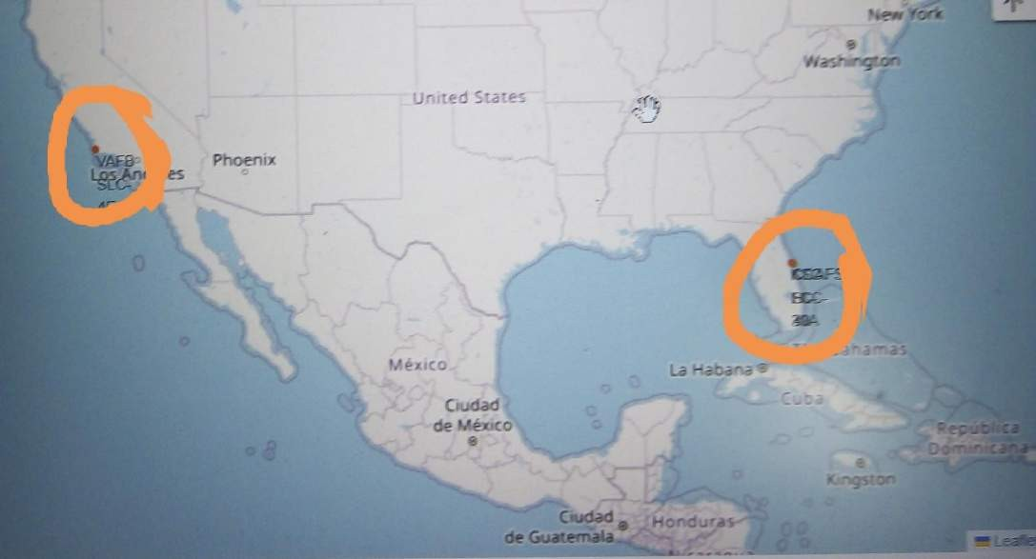
Launch Sites Locations
1- We can see that all launch sites are near the coast line.
2- Also launch sites are near to the ecuator line, his makes sense as it takes less fuel to get into space from the equator

Slide 53
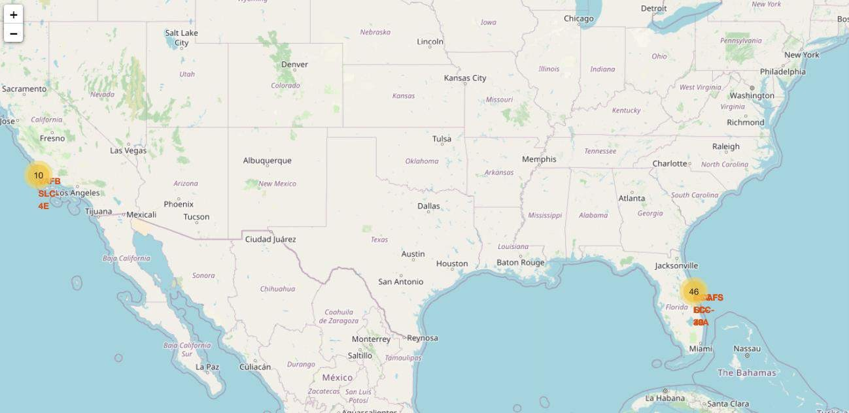
For each launch result in spacex data frame,
we added a folium marker to marker cluster

Slide 54
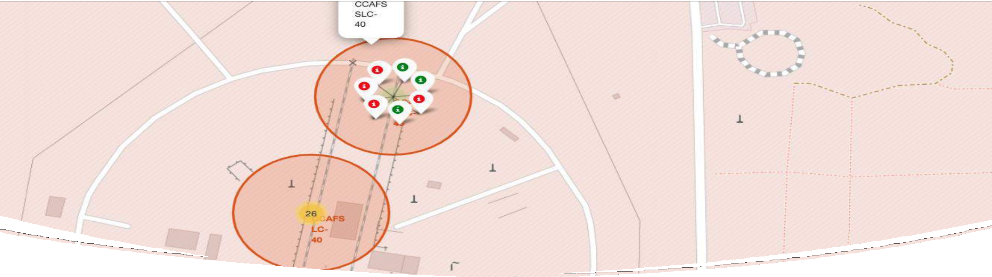
Markers showing launch sites with color labels

Slide 55
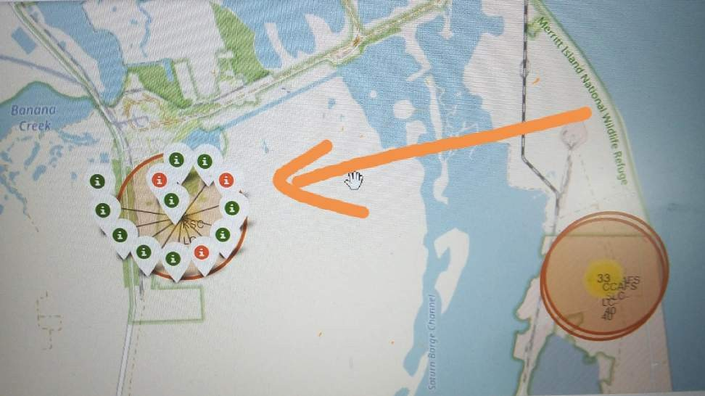
Sucess rate of Spacex launches
The successful launches are represented by a green marker while the red marker represents failed rocket launches.
It appears that KSC LC 39A has the highest success rate of rocket launches

Slide 56
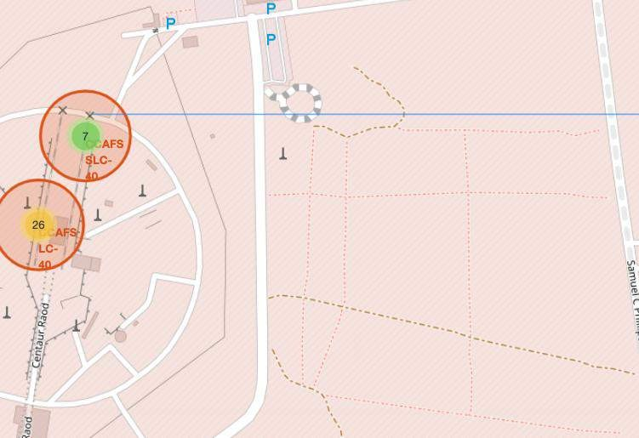
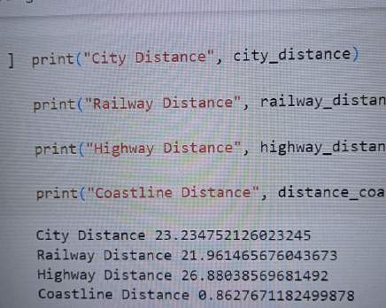
Calculate the distances between a launch site to its proximities
57

Slide 57

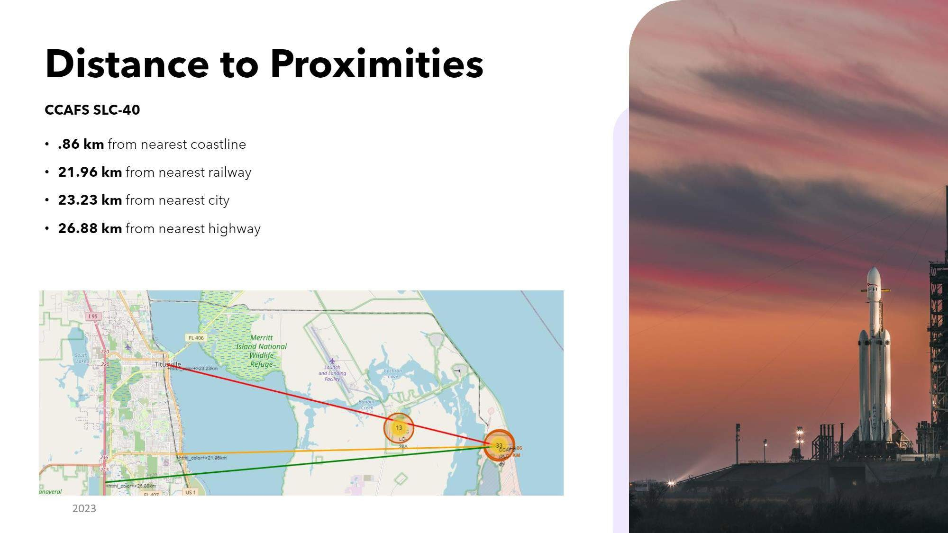

Slide 58
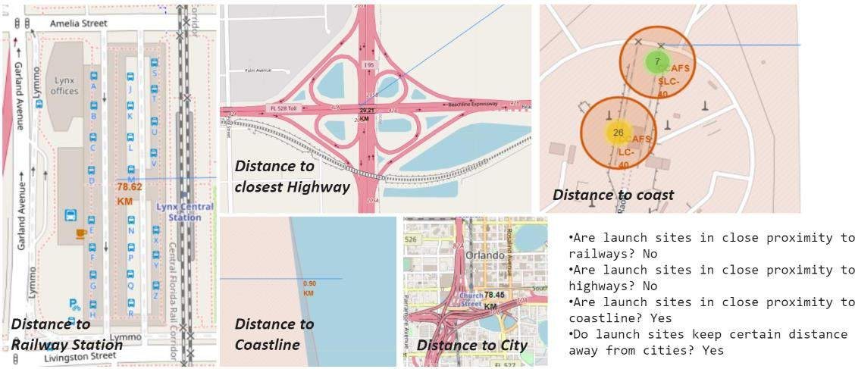
Launch Site distance to landmarks
59

Slide 59
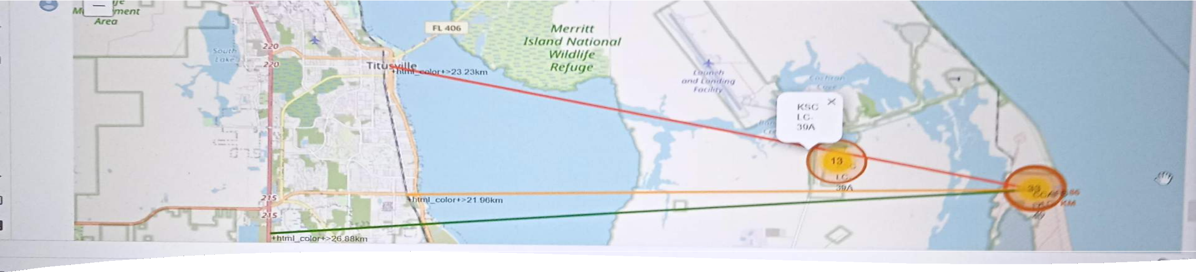
Launch sites are set up at about 20 km from cities, and one reason can be to prevent any crashes near populated areas.-
Launch sites are in very close proximity to railways and highways, maybe because it's necessary transportation requirements for rocket parts.
The sites are close to the coastline possibly due to the many rocket landing tests on the ocean .
Pollylines: Launch Sites to Landmarks

Slide 60


Slide 61
Build a Dashboard with Plotly
Dash Summary
Pie charts and scatter charts were used to visualize the launch records of SpaceX.
These charts displayed the rocket launch success rate per launch site. The factors that may have been influencing mostly the success rate at each site are the the payload mass and booster versions.
Successful launches were represented by 1 while failures were represented by 0.
https://github.com/singulritarian7/Capstone-
Spacex/blob/master/Piechart_allsites.jpg
https://github.com/singulritarian7/Capstone- Spacex/blob/master/Slider%20dash.jpg
https://github.com/singulritarian7/Capstone-
Spacex/blob/master/spacex_dash_app.py

Slide 62
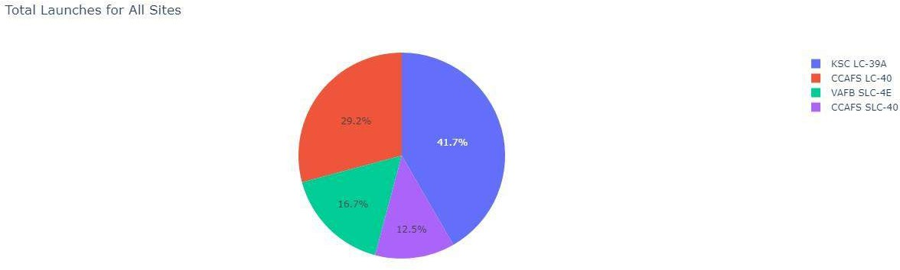
Success launches by all sites
We have the success rates of each launch site
Site KSC LC-39A has the most successful launches of all the sites

Slide 63
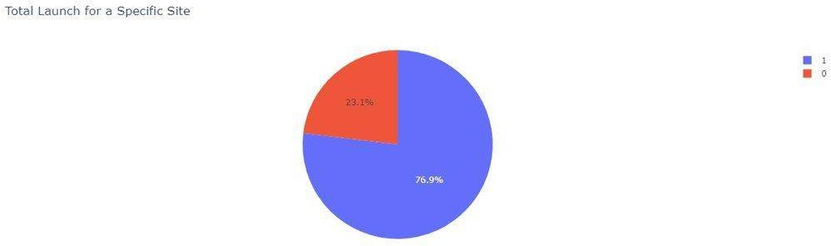
Total successful Lunches for site KSC LC-39A As we can see the success ratio is 97 %

Slide 64

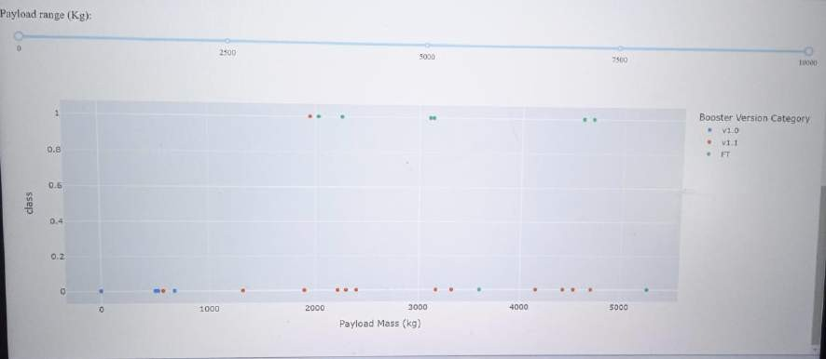
Payload Mass vs. Launch Success for All Sites
Payload range between 0-2500 kg has very low success rate for every booster version
Payload range between 2500 –5000kg , we see the booster version FT has the highest success rate and v1.1 the lowest
65

Slide 65

Section 5

Slide 66
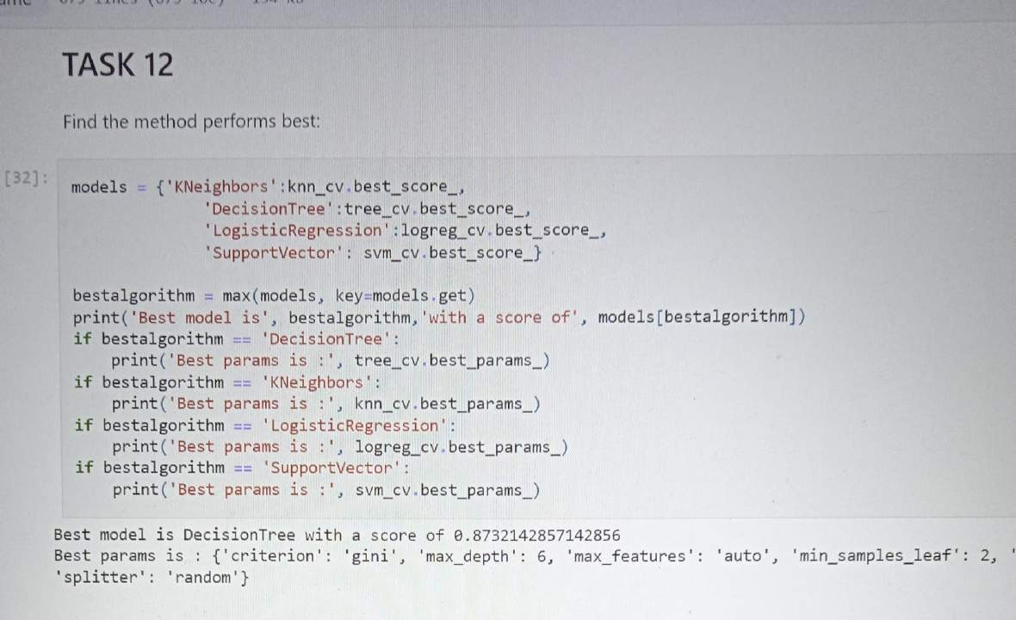
Classification Accuracy
The Decision Tree classifier has the higher accuracy , 0.87
67

Slide 67
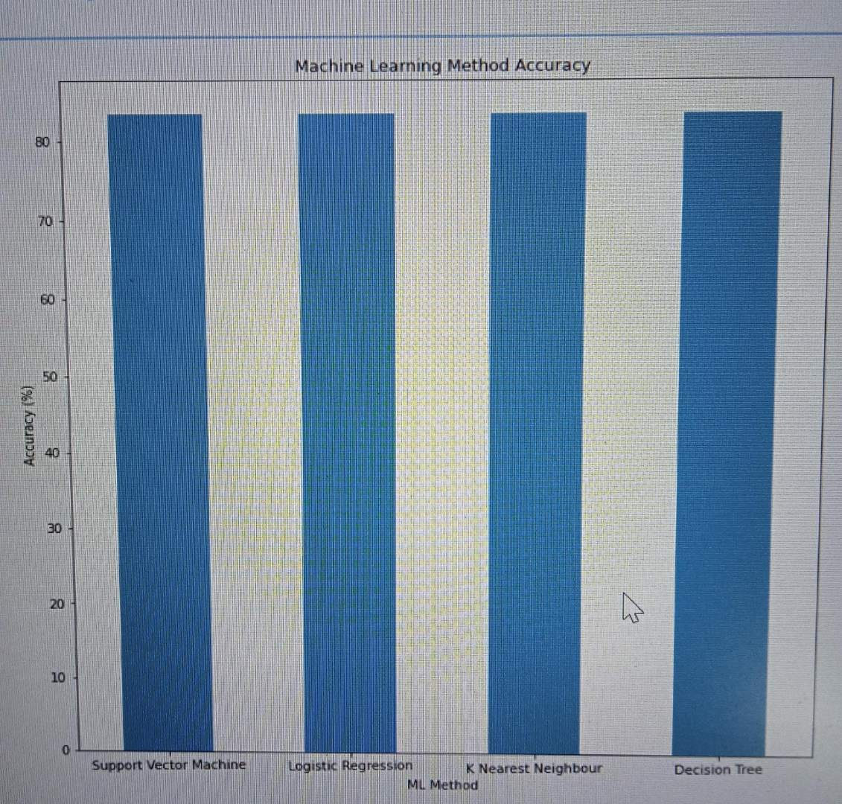
Classification Accuracy
Bar chart of the accuracy of the different methods

Slide 68
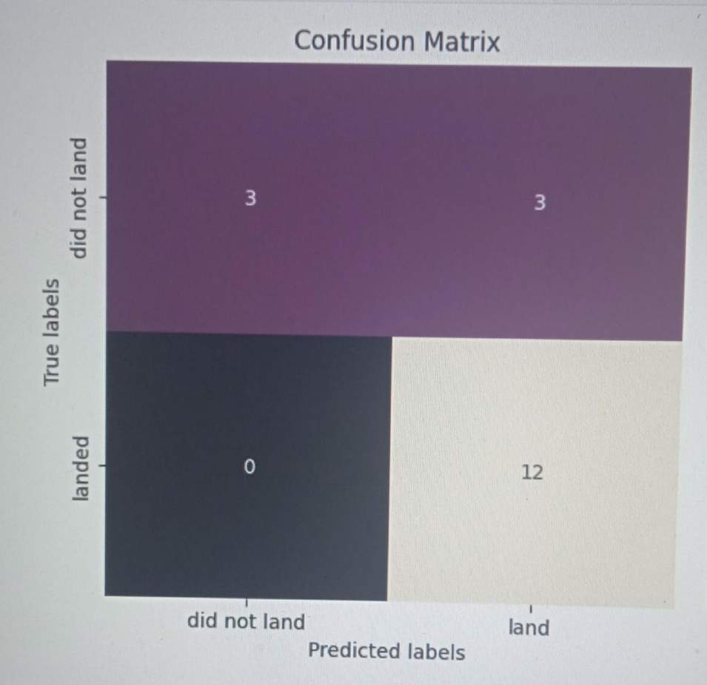
Confusion Matrix
- The chart shows the confusion matrix of the decision tree classifier
.- The model only failed to predict 3 labels
69

Slide 69
 Site KSC LC-39A had the highest launch success rate of all the launch
 All the launch sites are located near the coast, away from nearby cities
sites
Since 2015 the success rate of launches increased with flight number
Payload range between 0-2500 kg has very low success rate for every booster version
Conclusions
Payload range between 2500 –5000kg , we see the booster version FT has the highest success rate and v1.1 the lowest
This data was used to train a ML model, decision tree classifier, to predict the landing outcomes of rocket launches with 87 % of accuracy
70

Slide 70
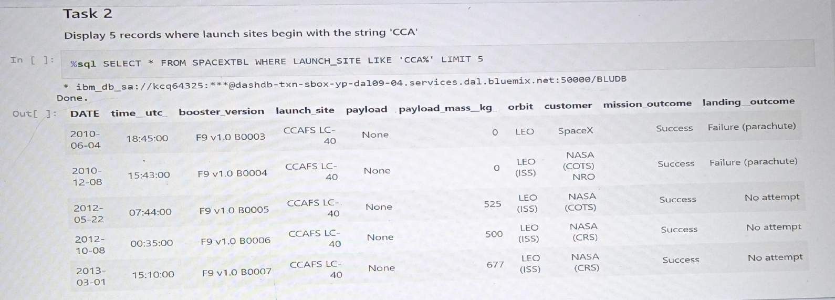
Appendix
SQL query of launch sites beginning with "CCA"
Github repo: https://github.com/singulritarian7/Capstone-Spacex
71

Slide 71


